Slide 1


Period End Closing Execution (BSC)
Period End Closing Overview
Period End Closing Key Process Areas and New Period End Checks
Post Closing Activities
Year End Specific Closing Activities

Slide 2
Period End Closing Execution (BSC)
Period End Closing Key Process Areas and New Period End Checks
Posting Period Control
Intercompany and Period End Closing
Lease Accounting and Period End Closing
Cost Management Closing Activities
Period End Closing for Accruals and Recurring Entries
Period End Data Checks
Asset Accounting Closing Activities
VAT Clearing and Reporting
GR/IR Closing Activities
Material Ledger Closing (Non-GSC Activities)
Automatic Clearing of LSC¹⁾ Accounts
G/L Closing Activities for Financial Statement Preparation
¹⁾ LSC – Accounts with indicator “Clearing Specific to Ledger Groups” active.

Slide 3
Posting Period Control Overview
Material Management (MM) Period Control
Financial Accounting (FI) Period Control
Controlling (CO) Period Control
T-Code: MMPV
T-Code: OB52
T-Code: OKP1
FCC Task:
Entity Level
FCC Task:
Global Level
FCC Task:
Global Level
Timing: WD-1
Timing: Throughout the closing (WD-3 to WD3 for IFRS, to WD10 for STAT/TAX) ¹⁾
Timing: WD14 (end of closing for all core ledgers)
FCC Task for Global Level would be handled by GBS Warsaw (T-Code OB52 (FI) & OKP1 (CO))
FCC Task for Entity Level would be handled by GBS/JTBC Team respectively (MMPV)
1) Exceptions exist. See Period End Closing Overview course.
Final closing of STAT/TAX posting period will be WD14, with an FCC task.

Slide 4
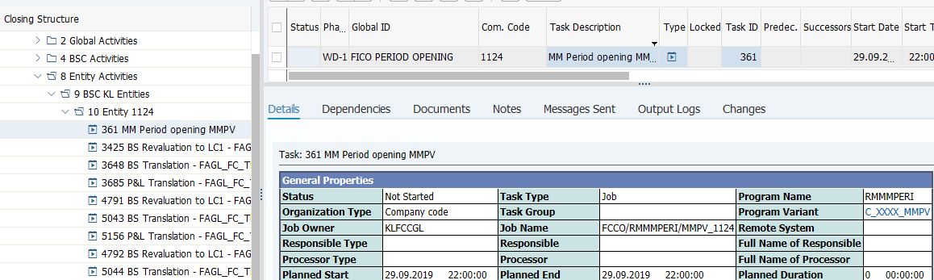
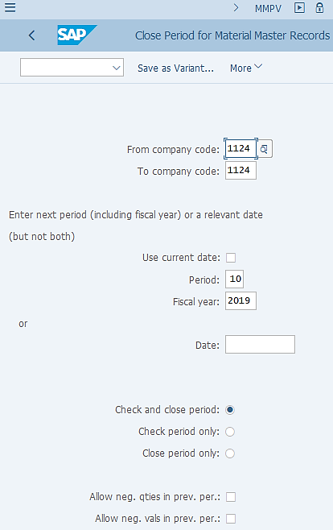
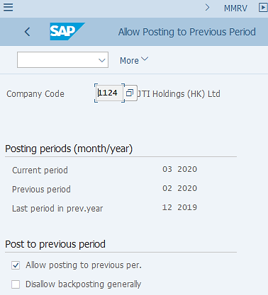

Posting Period Control: MM
FCLOCO - FCC Task List Display
MMPV – Change MM Period
Remember this is a “global variant” therefore Company Code must be reviewed / amended when used for execution outside of FCC!
MMRV – Check/Display MM Period
In ECC, MM Period Opening was not done via FCC but this has since been added to FCC in S/4HANA.
Review and updated the Company Code, Period/Fiscal Year fields before executing the transaction outside of FCC.
If you wish you may validate that the period has been changed via T-Code MMRV.

Slide 5
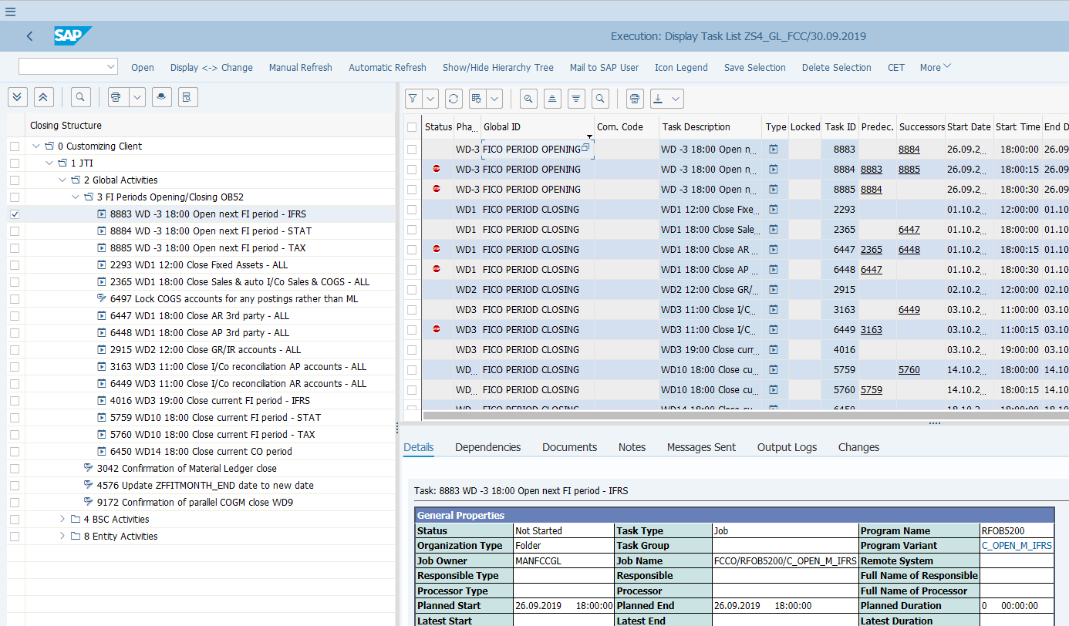
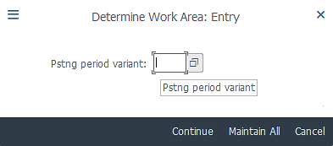
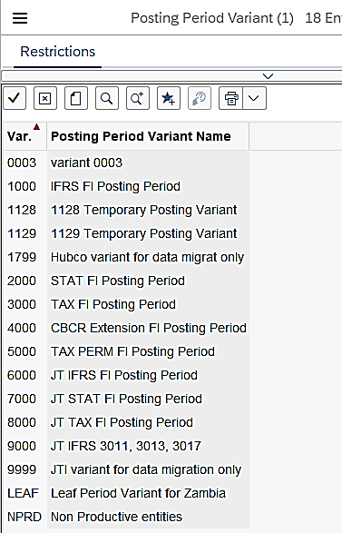
Posting Period Control: FI (1/2)
FCLOCO - FCC Task List Display
OB52 – Change FI Posting Period
New FI Period is open for all accounts on WD-3.
FI Period closing is done on different closing days for different sets of accounts (e.g. Asset Accounts, GR/IR accounts, Customer/Vendor Reconciliation accounts, etc.) as per the Global Closing Schedule.
In Parallel Ledger environment, different Posting Period Variants are created for each ledger (e.g. 1000 for IFRS Ledger 0L, 5000 for Tax Extension Ledger T1, etc.) There are also JT specific posting period variants which are controlled by JTBC.

Slide 6
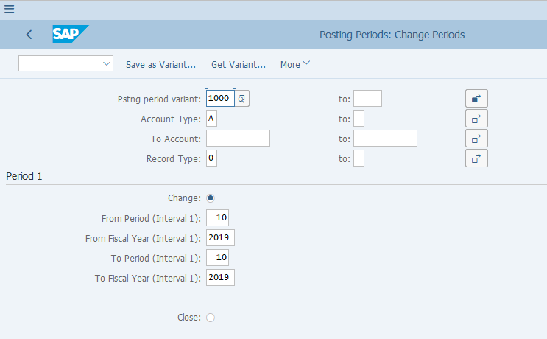
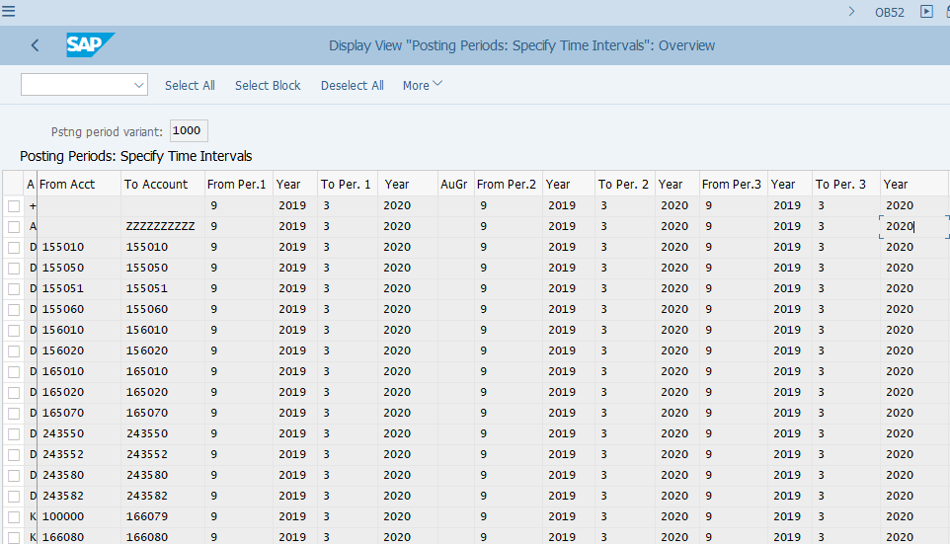
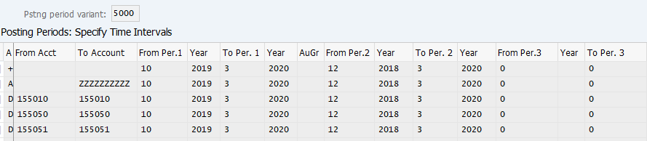
Posting Period Control: FI (2/2)
Program for changing FI Posting Period executed by FCC
The program executed by FCC has a different view as compared to the end user T-Code OB52, however when either of these are used, we need to maintain the posting period intervals by specifying the Account Type (and account ranges in some cases).
In S/4 HANA, 3 period intervals can be maintained for each Posting Period Variant. (Note the examples shown are from training environment. In production environment we normally only keep the current period open, plus the previous period during closing.
OB52 – Change FI Posting Period
You can make use of the 3 intervals to maintain different allowed posting periods. This is particularly useful if we are already in a new fiscal year but still allow some postings in P12 or special posting periods of the previous fiscal year. See below example.
OB52 – Change FI Posting Period

Slide 7
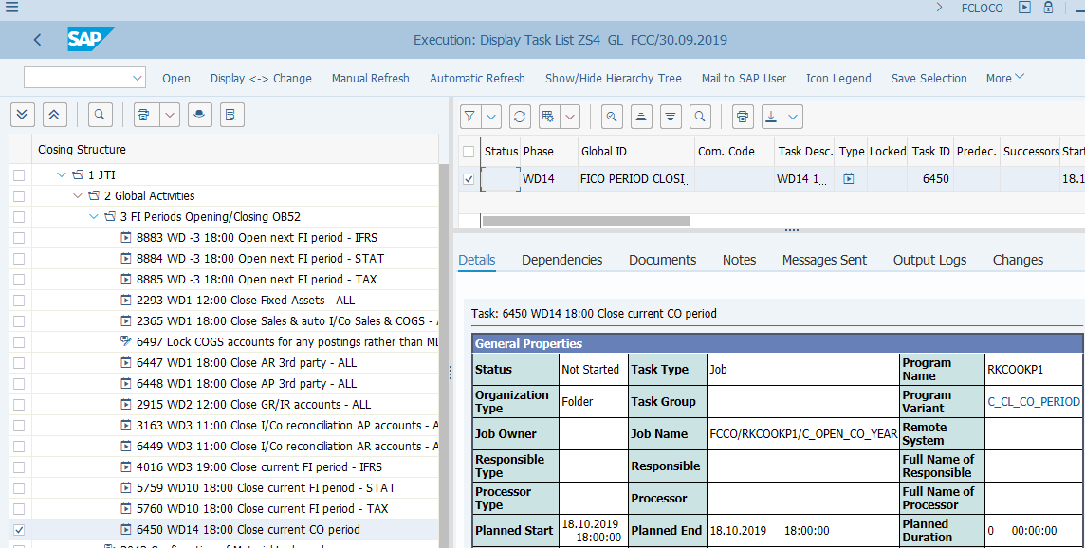
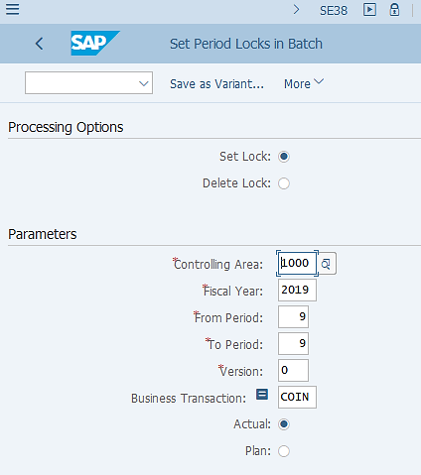
Posting Period Control: CO (1/2)
In S/4HANA, the Universal Journal concept means that transaction data in FI and CO are combined. This requires both FI and CO posting periods to be open in order for a financial transaction to be posted.
The period control in CO is organized by “Business Transaction”, which indicates the source of a posting to the CO module. E.g. whether a posting is related to cost center allocation, to FI posting or a settlement, etc.
There are also different CO period controls for Actual and Plan. For Period End closing purpose, we only refer to Actual in CO period control.
There is one monthly FCC task for CO Period Control, which closes the CO period every month, as the CO period is opened for full year prior to the beginning of a new fiscal year.
¹⁾
¹⁾ Note that Business Transaction COIN is excluded from the CO period lock. This Business Transaction allows postings to be made from FI to flow to CO. This is excluded from period lock because there are exceptions which allow certain entities to submit MyRequest journal templates for already closed FI periods, in which cases the GBS only needs to temporarily open the required FI period without touching the CO period control.

Slide 8
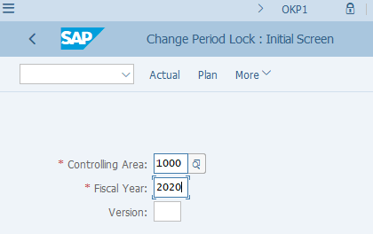
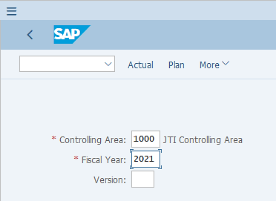
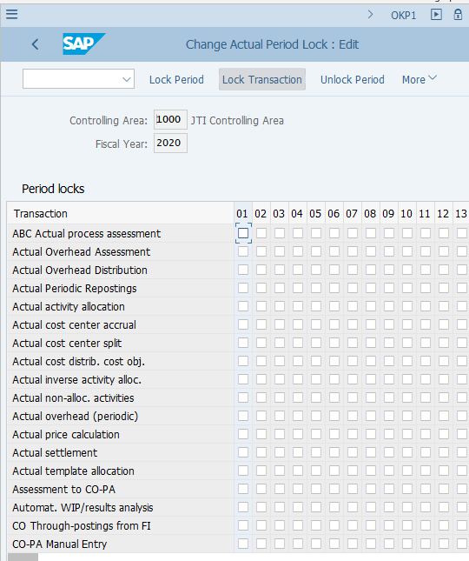
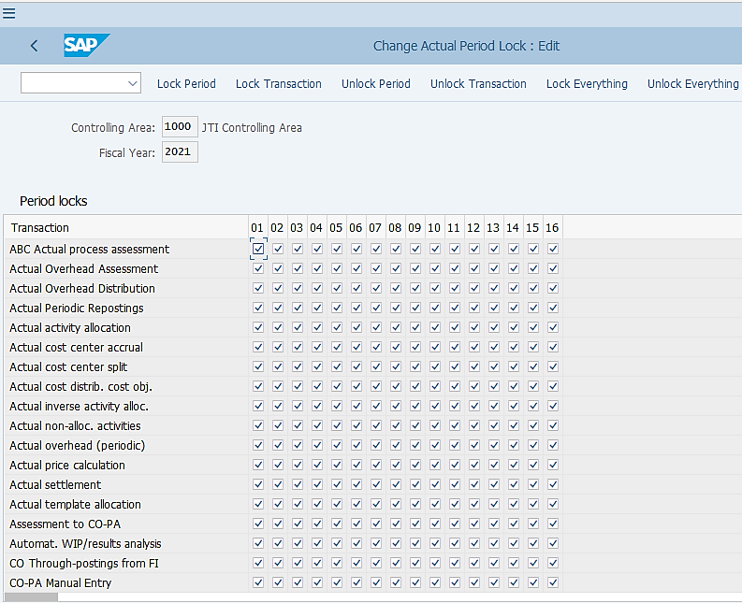
Posting Period Control: CO (2/2)
OKP1 – Change CO Period Lock
OKP1 – Change CO Period Lock
On WD-3 of P12, you should open all CO periods of the following year, as per Global Closing Schedule.
Normally the CO periods are already open in a new fiscal year by system default (unless someone manually locked them earlier as shown below!), therefore most likely you only need to perform a check rather than unlocking anything.
When manually locking CO period via OKP1, make sure you leave the line for
“CO Through0postings from FI” unlocked.

